Slide 1
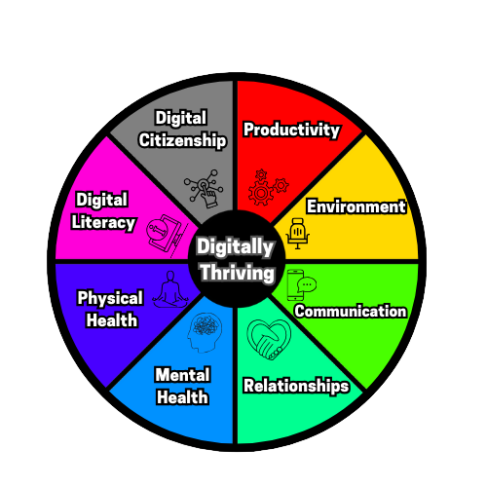
Digital Wellness
Digital wellness is the practice of maintaining a healthy and balanced relationship with technology. It involves being mindful of how much time we spend online, setting boundaries for technology use, and incorporating intentional activities that promote physical, social, emotional, and mental well-being into our daily routines.

Slide 2
Digital Citizenship 101:
Empower, connect, and thrive online!
Lethbridge School Division

Slide 3
Let’s get
into it!

Slide 4
Brain Check
What does “WWW” stand for in relation to the Internet?
Notes:
🍐 This is a Pear Deck Text Slide
🍐 To edit the type of question, go back to the "Ask Students a Question" in the Pear Deck sidebar.

Slide 5
Inquiry Question
In what ways does our online behavior impact our digital footprint and reputation, and how can we ensure that our actions in the digital world align with our values and intentions?
Notes:
🍐 This is a Pear Deck Text Slide
🍐 To edit the type of question, go back to the "Ask Students a Question" in the Pear Deck sidebar.

Slide 6
Online Presence
Learning to manage an online presence is crucial, as it allows one to safely and effectively navigate the vast interconnectedness of the world wide web.

Slide 7
TABLE OF CONTENTS.
01 | Digital Citizenship
02 | Privacy
03 | Passwords
04 | Cyberbullying
05 | Social Media
06 | Digital Ethics
07 | Digital Footprint
08 | Awareness
Browsing with safety and certainty
Protect your information and confidentiality.
4 C’s of 21st century learning
Our choices online have impact and meaning.
Navigating these platforms safely.
Behaviour online
What we leave behind us…
Preparedness leads to increased awareness

Slide 8
1.Digital Citizenship
Digital Citizenship
Citizen:
Belonging
Rights
Responsibilities
Privileges
Notes:
🍐 This is a Pear Deck Multiple Choice Slide. Your current options are:
🍐 To edit the type of question or choices, go back to the "Ask Students a Question" in the Pear Deck sidebar.

Slide 9
1.Digital Citizenship
What is Digital Citizenship?
4 C’s to recall when navigating online
Collaboration
Communication
Critical Thinking
Creativity
Notes:
🍐 This is a Pear Deck Multiple Choice Slide. Your current options are:
🍐 To edit the type of question or choices, go back to the "Ask Students a Question" in the Pear Deck sidebar.

Slide 10
Which of the following was NOT one of the “C”’s we discussed in relation to Digital Citizenship?
Notes:
🍐 This is a Pear Deck Multiple Choice Slide. Your current options are: A: Communication, B: Community, C: Correlate, D: Critical Thinking, E: Collaboration,
🍐 To edit the type of question or choices, go back to the "Ask Students a Question" in the Pear Deck sidebar.
Sharing Thoughts
Often, you only have time to call on a few students, but who to call on? You don’t want to call on the same eager voices all the time, but you also don’t want to put a student on the spot. After students have time to answer your last question, use this slide to quickly see who feels comfortable to share their thoughts. You might find willingness from students who don’t normally raise their hands.

Slide 11
2. Understanding Internet Privacy
Tips & Tricks
Lock devices
Safe downloads
Be cautious when connected to public wifi
Seek clarification/collaboration

Slide 12
Drag your dot to which concept demonstrates strong Internet Privacy awareness?
I keep my devices unlocked
I always seek an adult or trusted peers opinion when I feel unsure of something.
I love downloading anything and everything offered!
Notes:
Temperature Check
WIth this slide, you can get a quick idea of how your students are feeling about the pace of the lesson. Getting consensus before moving on helps ensure everyone is still with you, and identify the students who might need extra attention.
🍐 This is a Pear Deck Draggable™ Slide.
🍐 To edit the type of question, go back to the "Ask Students a Question" in the Pear Deck sidebar.

Slide 13
3. Strong Passwords
Create passwords and protection settings to keep your data safe.
Maintain ownership and privacy
Unique account information
Avoid using key demographic information (name, birthday, favourite numbers)
Capitalization: Not just at the beginning
Use numbers,characters, or symbols
Use two factor authorization if available
Password recall systems- Physical Spaces

Slide 14
Use the letters in word bank to label are examples of Strong passwords to use online :
Word Bank
Mall00
<keLLogsCereal501>
farmHouse624*
School
GrapeFrUiT816!
Notes:
Label the Diagram
This is an example of a labeling activity. Swap the bee image out for your own illustration, diagram, or map. You can use the Word Bank to prompt students with the labels they need to use.
🍐 This is a Pear Deck Drawing Slide
🍐 To edit the type of question, go back to the "Ask Students a Question" in the Pear Deck sidebar.

Slide 15
Curate examples of your own strong passwords below:
Use a capital in the middle of this one: | Use numbers somewhere within this password:
Add a character (other then letters) to this example: | Be appropriately creative here and include all elements of a strong password?
Notes:
Reflection
Use this template to gather feedback about today’s lessons and to prompt metacognitive thinking.
🍐 This is a Pear Deck Drawing Slide
🍐 To edit the type of question, go back to the "Ask Students a Question" in the Pear Deck sidebar.

Slide 16
4.Cyberbullying
What is Cyberbullying?
Use of electronic communication to bully a person, typically by sending a message of an intimidating or threatening nature
How can we prevent cyberbullying?
Don’t engage in gossip or hurtful posts if you wouldn't say it in person, don’t type it online.
What to do if you see cyberbullying?
Say something- support the victim- step away and process next appropriate steps
What to do if you or a known party experiences cyberbullying?
Stop-Block-Talk-Save.

Slide 17
To engage back in adverse conversation online is an appropriate response to cyberbullying?
True
False
Notes:
True or False
Use this template to do a quick check of students’ perceptions during your lesson.
🍐 This is a Pear Deck Multiple Choice Slide. Your current options are: A: True, B: False,
🍐 To edit the type of question or choices, go back to the "Ask Students a Question" in the Pear Deck sidebar.

Slide 18
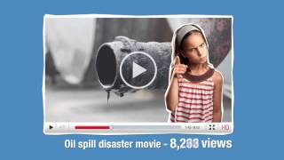
5. Social Media Strategies
Balance
Timers
Filter valuable content
Community
Canva Link

Slide 19
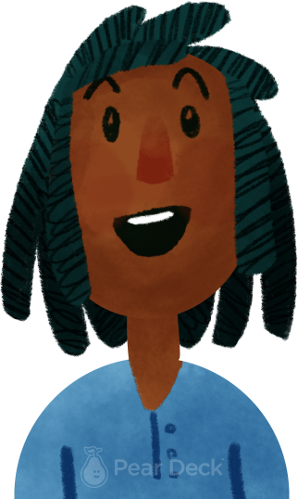
What are some digital wellness strategies you can share when using Social Media?
Notes:
Thinking Broadly
Identifying and articulating questions we have is an important thinking skill. Give students the opportunity to think broadly about today’s topic and identify their own questions. Show their responses anonymously on the projector to discuss.
🍐 This is a Pear Deck Text Slide
🍐 To edit the type of question, go back to the "Ask Students a Question" in the Pear Deck sidebar.

Slide 20
6. Digital Ethics
Digital ethics
Transparency
Avoid bias and prompt openness
Generative dialogue
Intellectual property

Slide 21
Digital ethics refers to the choices, behaviours and actions we share online? (Green=True) or (Red=False)
Notes:
Hard or Easy
Use this template to do a quick temperature check and self-reflection about the homework. You can learn which students might have struggled with the assignment and therefore might need more attention today.
🍐 This is a Pear Deck Draggable™ Slide.
🍐 To edit the type of question, go back to the "Ask Students a Question" in the Pear Deck sidebar.

Slide 22
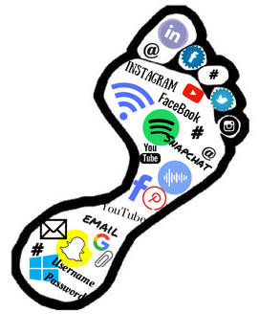
7. Digital Footprint
The imprint we leave on the world wide web
Encompasses all generated and residual information and data.
Digital accountability
Everlasting
Online resume for future considerations

Slide 23
Digital Footprint
“Our digital footprint is easily erased?”
If I repost something that adds to my digital footprint?
Type Yes or No in your agreeance with each statement presented in the box
Future employers may potentially view my digital footprint?
I should start to monitor my digital footprint after high school?
Notes:
Reading Support
Use this template to help students separate different parts of a reading. They can use the Typing Tool to fill in each area.
🍐 This is a Pear Deck Drawing Slide
🍐 To edit the type of question, go back to the "Ask Students a Question" in the Pear Deck sidebar.

Slide 24
8. Awareness
Be aware of the wide space the internet is. There are individuals out there who are preying on scams, hoaxes, and vulnerability.
Awareness Safety 101:
If you have never met the alleged business, company, or individual in person. Don’t share any of your information.
If it is an unknown area code or number calling. Avoid engaging in sharing any of your information.
Ask for verification of their title, business, or source they’re representing.
Aggressiveness
Validity
Social sharing usernames

Slide 25
If I’ve met someone exclusively online, it is friendly to share and exchange personal information?
True
False
Notes:
True or False
Use this template to do a quick check of students’ perceptions during your lesson.
🍐 This is a Pear Deck Multiple Choice Slide. Your current options are: A: True, B: False,
🍐 To edit the type of question or choices, go back to the "Ask Students a Question" in the Pear Deck sidebar.

Slide 26
Where do we go from here?
Choose one particular skill to focus on. Knowledge is the first step in the process, putting it into practice and actionable activities to consciously change a habit or behavior.
Focus on what causes/risk factors that cause actions or behaviours to occur?
Ex: Cyberbullying-
Usually occurs later in the evening and is linked to sleep deprivation and heighten emotions.
Lack of sleep often creates impulsive choices.
If we focus on planning and goal setting for sleep patterns perhaps we can address the ending action of cyberbullying occurring.

Slide 27
Draw lines to match the example to its appropriate term:
Cyberbullying
Download only from reputable sources
Digital
Footprint
Set boundaries
Digital
Citizenship
If you wouldn’t say in person, don’t type it
Privacy
The imprint we leave online
Social Media Strategies
Talk, support, and step away
Digital Ethics
4 C’s (Collaborate, communicate, critically think, creative)
Notes:
Matching
This is an example of a matching activity. Change the terms to fit your own content.
🍐 This is a Pear Deck Drawing Slide
🍐 To edit the type of question, go back to the "Ask Students a Question" in the Pear Deck sidebar.

Slide 28
Digital presence is like driving a car- we need to learn the rules of the road and use technology responsibly to stay safe and protect others.
-Maryalice Curran

Slide 29
Digital Citizenship 101:
Extension of Learning Activities
Lethbridge School Division

Slide 30
Scenario(s)
Small groups: 4-5 Students
Prep time: 12-15 Minutes (on the clock).
Presentation: Can be a short “one-act” play, generative solution based, or student choice(upon request).
Keen in on: What skills does the individual(s) need to model to make informative, educational, and uplift choices that reflect and promote growth and overall wellness within each scenario presented.
Link

Slide 31
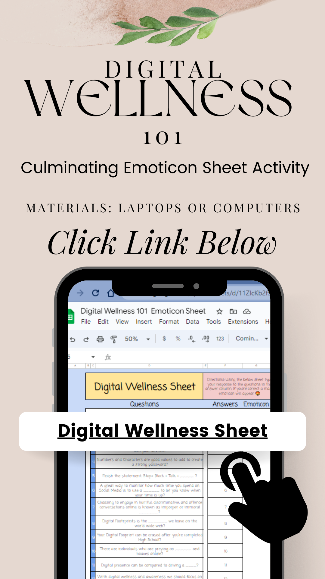
Sheet(s)
Link
Open Internet Browser
Go to:
Digitalwellnessteam.schoolsites.ca
Top Right: CLICK “QUICK LINKS”
Look for then click:
Digital Citizenship: Assessment of Learning Sheet
It will download in your downloads folder.
Open the excel sheet and select “enable editing”
Follow instructions on the sheet to complete assessment of learning.

Slide 32
Sheet(s)
Link
Individual Assessment: Computer Station
Work time: 15-20 Minutes (on the clock).
Student Instructions: Submit responses in the answer column to reflect on concepts learned.
Keen in on: Reflect back on any slides in the presentation as needed as we are in “Student paced mode” to guide your answer submissions.
When completed: Work on Digital Puzzle from the Digital Wellness Team’s Website

Slide 33
Digital Footprint(s)
Individual Assessment: Pencil-to-paper/ digital completion
Work time: 25-30 Minutes (on the clock).
Student Instructions: Reflect on your digital footprint by identifying and documenting the various online spaces where you leave traces and engage in digital activity.
Keen in on: Creativity, autonomy to individuals, current online presence, encouraging, uplifting, and purposeful presence.
Link

Slide 34
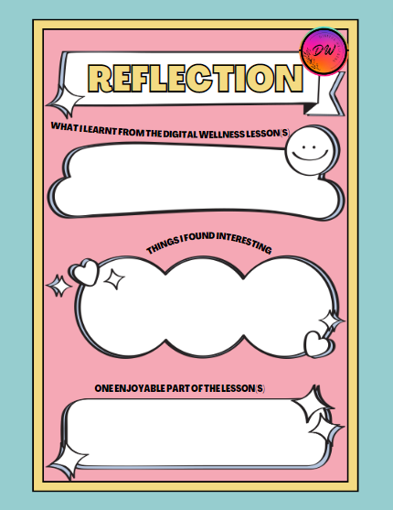
Reflection
Of Learning
Individual Assessment: Pencil-to-paper
Work time: 10-12 Minutes (on the clock).
Student Instructions: Submit a reflection of learning in relation to the Digital Wellness mini unit completed.
Keen in on: Specific takeaways, areas of focus for individual digital well-being, and encouragement our team can use moving forward!
Link

Slide 35
Curriculum Outcomes
Health & Life Skills
P.E. and Wellness Curriculum
Wellness
Learning Outcome
W-2-Positive health habits
W-8-Safety for self
W-9-Safety for others
Students analyze and apply conflict resolution.
Students examine risks and identify the factors that influence action.
Students consider and describe a variety of perspectives that support the development of healthy relationships.
Relationships
R-1- Awareness of feelings
R-4- Communication skills
R-6-Respectful relationships
Life Learning
L.L.-2- Lifelong learning
L.L.-3- Decision Making

Slide 36
Credits/Sources.
Tarver Academy (2023, March), Digital Citizenship Course. Tarveracademy.com. Tarveracademy.com
Burns, Monica. (2023, January 24). “Expanding the meaning of Digital Citizenship with Carrie Rodgers-Whitehead. Easy Edtech Podcast. Apple Podcasts.https://classtechtips.com/2023/01/24/meaning-of-digital-citizenship-199/
Presentation Template: SlidesMania
Sample Images: Unsplash
Fonts used in this presentation: IBM Plex Mono

Slide 37
THANK YOU!
Do you have any questions?
Cason.machacek@lethsd.ab.ca
https://digitalwellnessteam.schoolsites.ca/

Slide 38
EDITABLE ICONS

