Slide 1
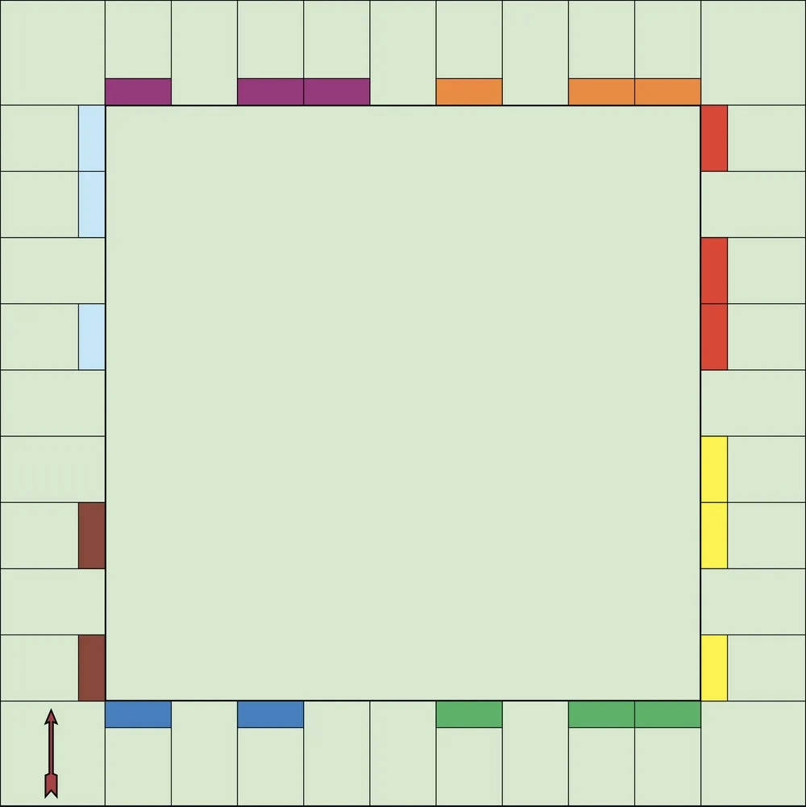
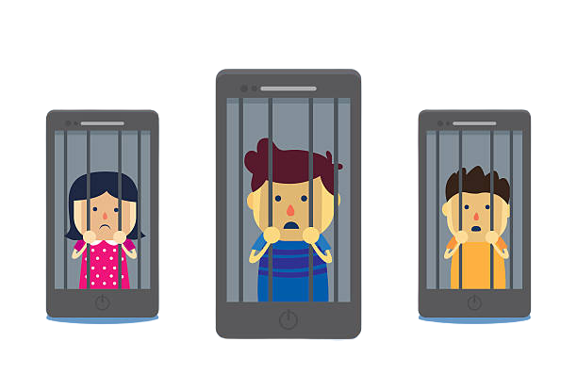
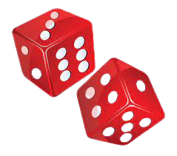
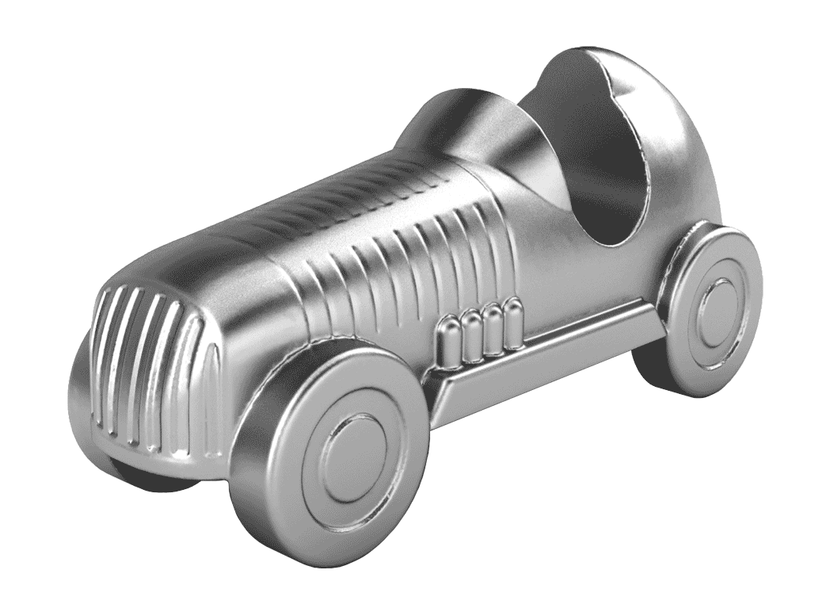
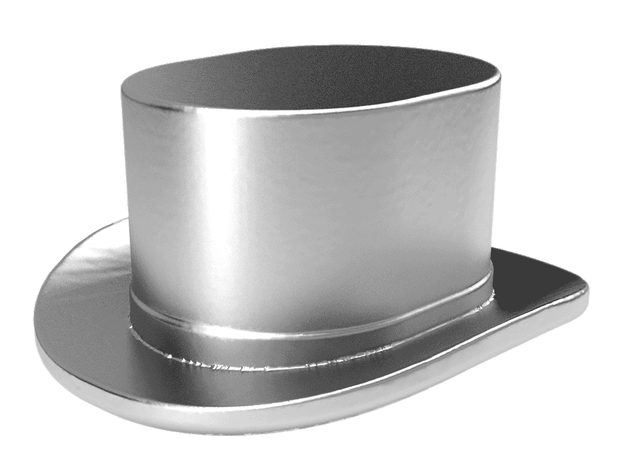
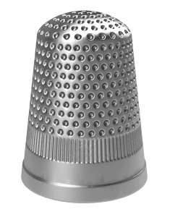
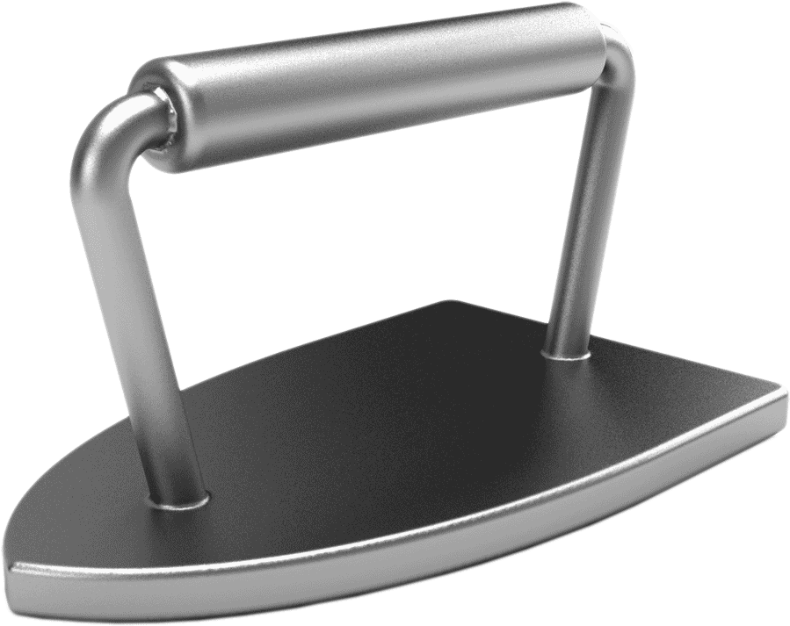
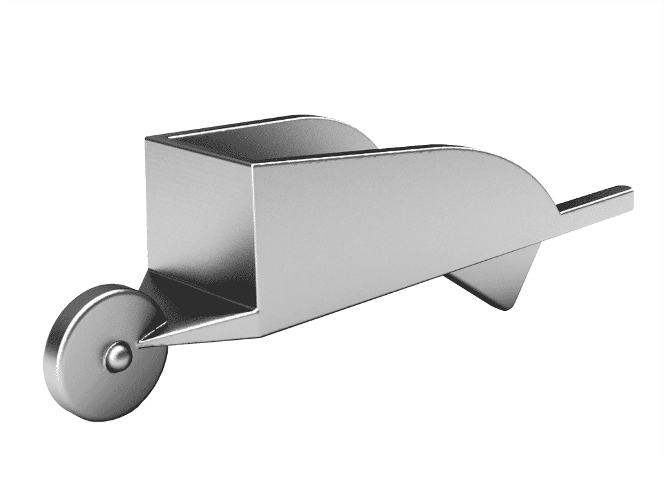
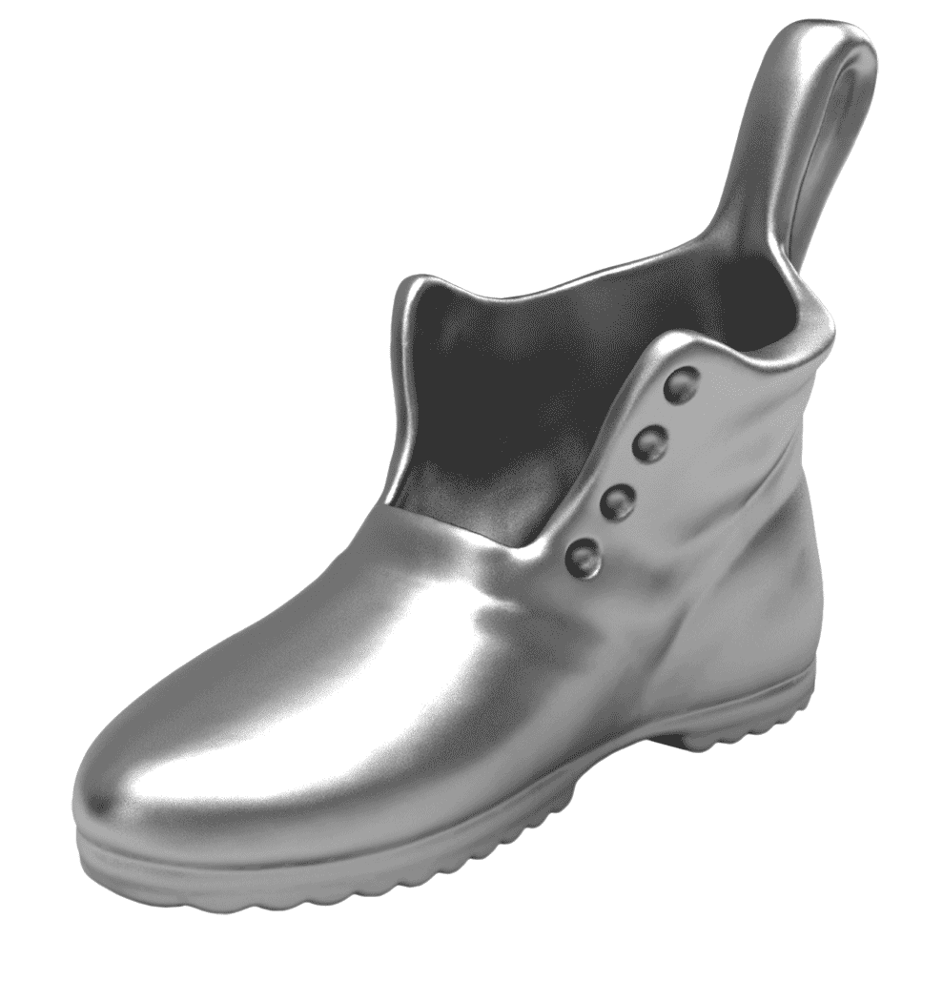
Roll
1
more dice
Skip in place for
30 Seconds
Move ahead
2
spaces
Jail
Tech Jail
Name one App that helps promote an element of wellness, then Begin Again at “Go!”
Pick your playing piece
Don’t have dice available?
Use this link to roll:
Virtual Dice
Tech
Digital Wellness
Jumping Jacks
Plank
for 30
seconds
High
Knees for 30 seconds
Abdominal
Twists
Virtual D.W. Monopoly Chance Cards
Virtual DW Chance Cards
Objective: Travel around the game board with your game piece the greatest number of times.
Start at “Go” on the game board.
Roll the virtual dice and move around the game board.
When you land on a specific space you get to perform that exercise or complete that action.
If you land on a space with color, roll the dice again and do the exercise that many times, then answer a virtual “Digital Wellness chance card.”
If answered correctly you receive one additional roll. If answered incorrectly, next player begins their turn.
Mountain Climbers
Run
in place for 30 seconds
5
Star Jumps
Plank
Tech Jail
Go to
NO EXERCISE
Kick backs for 30 seconds
Choose
an exercise from the board
Squat Jumps
Digital “Passed Go” Cards →
Push-Ups
Choose
an
exercise for someone else
Dance
to a
song
Sorry!
Go back two spots.
Go to
Collect one “passed go” card
Inch Worm
Tech Jail

Slide 2
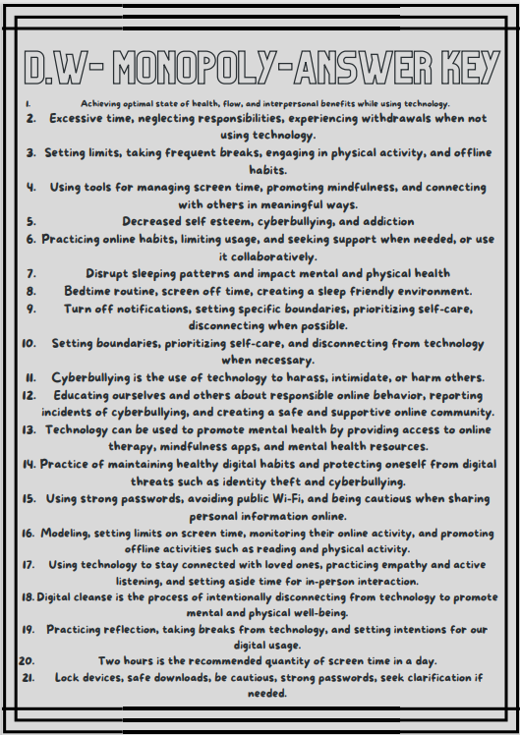
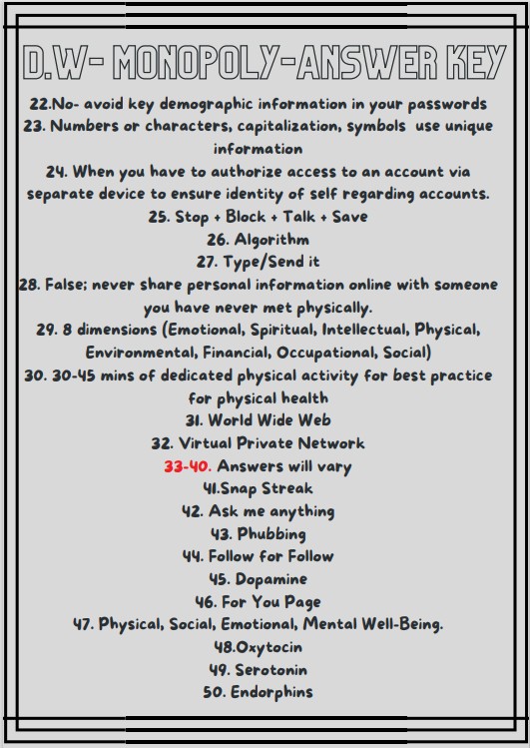

Slide 3
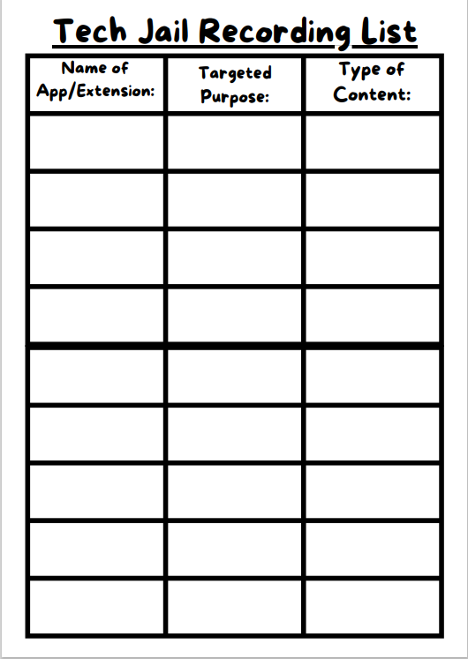

Slide 4
For full materials to print, laminate, and play without technology please click the below logo. Enjoy!

